Slide 1



LECTURE #6:
BAYESIAN S-FACTORS AND REACTION RATES

Slide 2
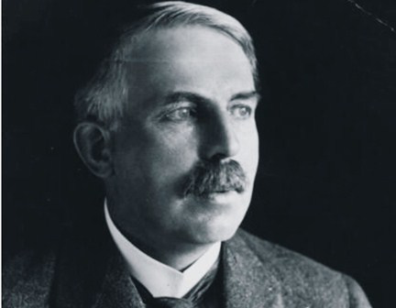
“If your experiment needs statistics, you ought to have done a
better experiment” ª
“We use fantastic telescopes, the best physical models, and the best computers. The weak link in this chain is interpreting our data using 100-year-old-mathematics” ^{b}
ª Ernest Rutherford [1871-1937]
^{b} D. Mackenzie, New Sci. 2453, 36 (2004)

Slide 3
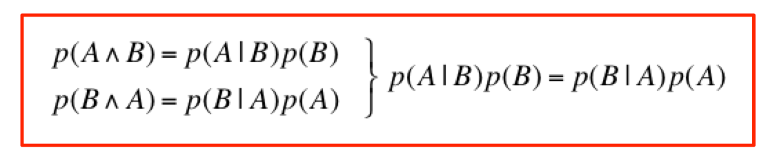
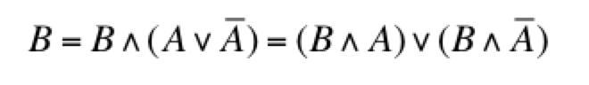
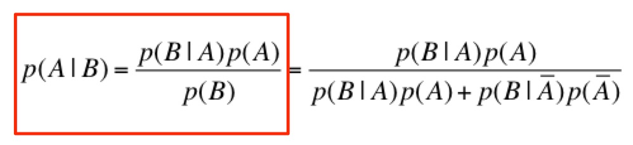
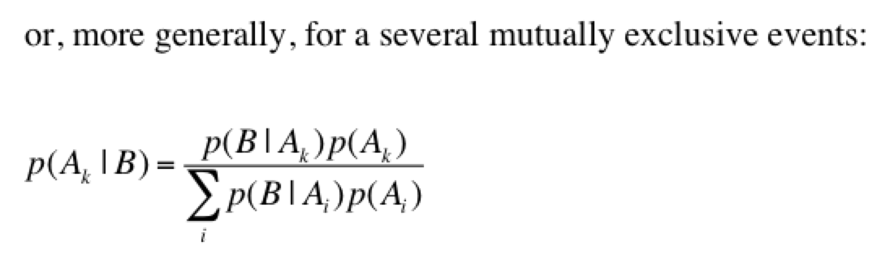
BAYES THEOREM: DERIVATION
P(a|b) means: “probability that proposition a is true, given that b is true”
Notes:
Interesting thing: Bayesian theorem applied to data (B)

Slide 4

BAYES THEOREM
PRIOR
POSTERIOR
LIKELIHOOD
Thomas Bayes
[1701-61]
EVIDENCE
P(a|b) means: “probability that proposition a is true, given that b is true”
H stands for a combination of PARAMETERS, θ, and MODELS, M
LIKELIHOOD: often mistakenly interpreted as “the most probable hypothesis
given the data”; this is incorrect; instead, it is: “the probability that we
obtained the data, given hypothesis H”
PRIOR: state of knowledge before seeing the data [probability density!]
maximum likelihood estimate is different from the posterior
Notes:
Bayesian statistics is used for PARAMETER ESTIMATION, PREDICTION, MODEL SELECTION

Slide 5
BAYESIAN STATISTICS I
number of research papers in astronomy, medicine, linguistics, political science, etc., that use Bayesian statistics is going through the roof
physics, including nuclear physics, is very very slow to adopt Bayesian methodsª
[however, see recent observation of gravitational waves by LIGO]
how serious is that stuff? when you think Bayesian statistics, think:
money ball (sports betting)
weather forecast
climate models
stock market
online poker
machine learning [artificial intelligence]
ª Udo von Toussaint, Bayesian Inference in Physics, Rev. Mod. Phys. 83, 943 (2011);
Andreon & Weaver, Bayesian Methods for the Physical Sciences, Springer (2015);
Cousins, “Why isn’t every physicist a Bayesian?”, Am. J. Phys. 63, 398 (1995)

Slide 6
BAYESIAN STATISTICS II
^{b}
50±5
what is the meaning of the error bar?
“1σ error bar”
if you say “there is a 68% chance that the true value is
located inside the error bar”, then you think like a Bayesian!
in Bayesian statistics, the parameter is a random variable
in frequentist statistics, the parameter is not a random variable; it is unknown and only mother nature knows its true value
a frequentist would say regarding a 68% confidence interval: “if the same population
is sampled many times, and 68% confidence intervals are determined on each
occasion, 68% of these intervals are expected to contain the true population
parameter”; a single confidence interval, based on a single measurement, either
contains the true parameter or not
a frequentist will not assign a probability to one-off events or to the value of a
physical constant
this gets you into all sorts of philosophical issues/debates/misunderstandings
^{b} Cumming & Finch, Inference by Eye, Amer. Psych. 60, 9170 (2005)
Notes:
...e.g., will the first astronaut to Mars return to Earth alive?...e.g., is the value of the strong coupling constant between 0.110 and 0.115?

Slide 7
BAYESIAN STATISTICS III
“evidence”, Z, sometimes called “marginal likelihood”, is a normalization
factor [and difficult to compute], but not needed in parameter estimation
if we know p(θ|D), we can compute:
probability for credible region
marginal parameter distribution
prediction of y_{p} for given x_{p}
except for the most simple cases, these integrals are intractable with the
usual numerical methods
Notes:
Remember: rejection sampling in 1D
prediction: for each θ we get a predictive distribution over y_p. We then average all of these, with a weighting factor (the posterior) which tells us how well that θ is supported by the data;
Or: draw a θ from the posterior; for each of the randomly drawn θ, randomly select values of y_p

Slide 8
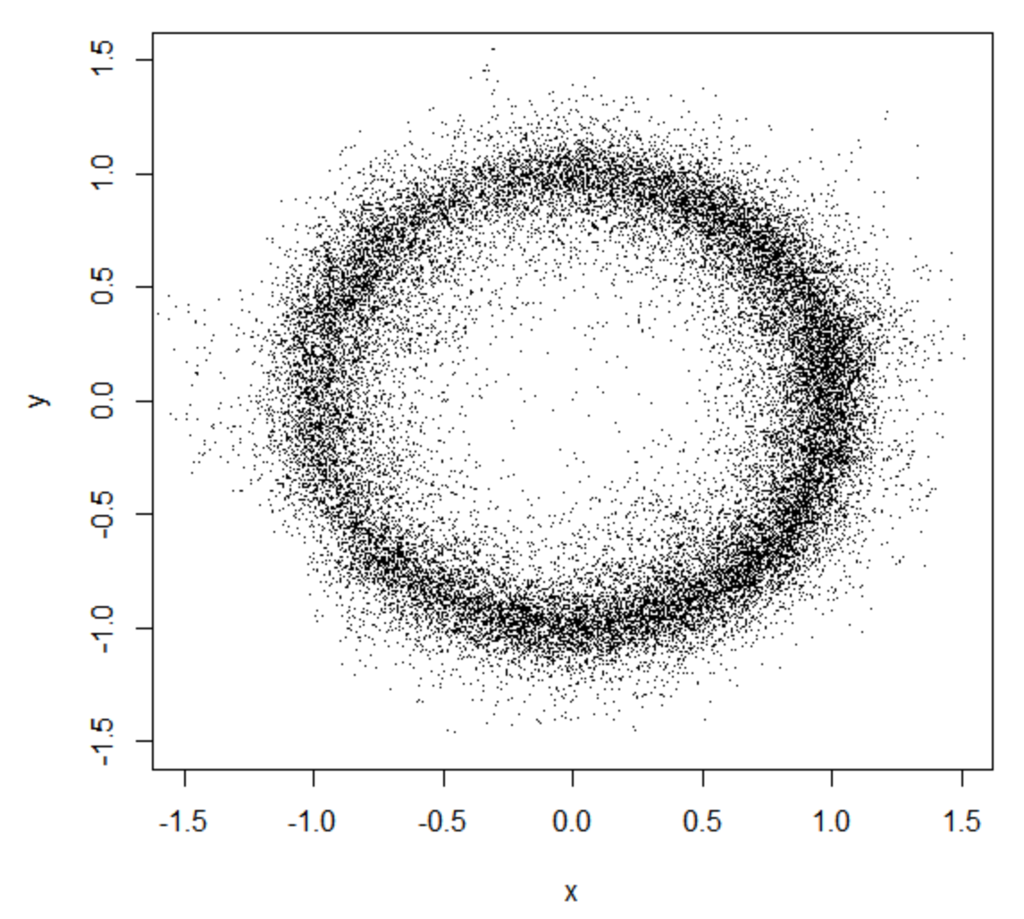
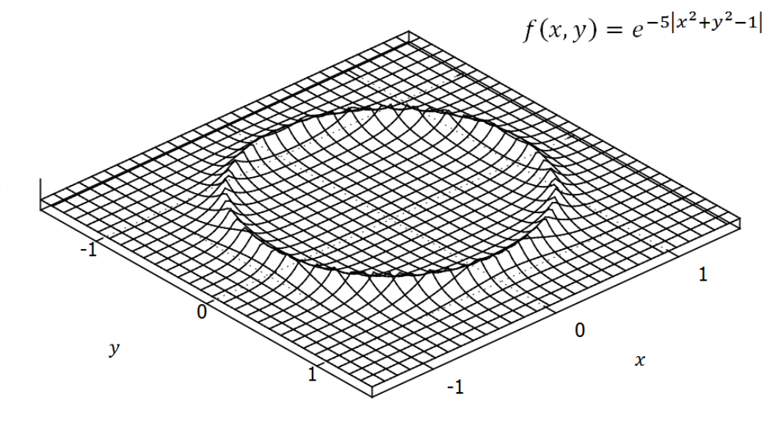
BAYESIAN STATISTICS IV
but even simply calculating the posterior, p(θ|D), is difficult in more than one dimension [in 1D or 2D: evaluate p(θ|D) on a dense grid]
strategy: the likelihood and prior are known; estimate the posterior by randomly drawing a large number of θ samples from it; the frequency distribution of the samples is then equal to the posterior, in the limit of a large number of samples
how do you draw samples, θ=(θ₁, θ₂,...,θ_{n}), from a multi-dimensional posterior?
Markov chain Monte Carlo: the single most important reason why Bayesian
statistics is taking over frequentist statistics [“MCMC revolution”]
Notes:
Graph on left: notice also that the 2D function needs to be evaluated in large areas where the probability is near zero
Graph on right: the sampling automatically focuses on areas with significant probability [40,000 samples]

Slide 9
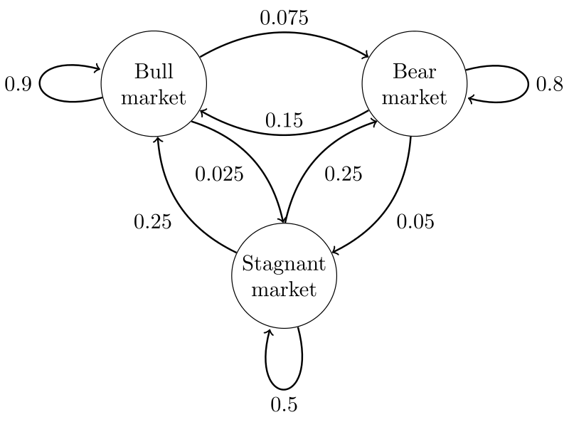
MARKOV CHAINS
what is a Markov chain?
a Markov chain is a random walk, where a transition from state i to
state j is independent of how state
i was populated [“memory-less”]
fundamental theorem of Markov chains:
for a very long random walk, the proportion of time [i.e., probability] the chain
spends in some state j is independent of the initial state it started from; this
set of limiting, long random walk, probabilities is called the stationary (or
equilibrium) distribution of the Markov chain
Notes:
If a chain is irreducible, positive recurrent, and aperiodic, we call it ergodic;
Markov chain: transition probabilities are fixed and do not change
If a chain reaches a stationary distribution, then it maintains that distribution for all
future time. A stationary distribution represents a steady state (or an equilibrium) in the chain’s
behavior.
Consider the total time spent once the chain reaches the stationary distribution. 6/25 = 24% of the time is spent in state 0.

Slide 10
MARKOV CHAIN MONTE CARLO
the fundamental problem we are trying to solve is how to draw
from a [known] multi-dimensional distribution p(θ|D)
the MCMC method constructs a Markov chain whose stationary
distribution is exactly p(θ|D); then you take a long enough random
walk and output the samples θ at every step; in other words, all
these samples are drawn from the posterior p(θ|D)
several related algorithms are known to solve this problem:
Metropolis, Metropolis-Hastings, Gibbs sampling, HMC, etc.;
the Metropolis algorithm has been called the most powerful
algorithm of all timeª
ª Beichl & Sullivan, The Metropolis Algorithm, Comp. Sci. Engin. 2, 65 (2000)

Slide 11
METROPOLIS-HASTINGS ALGORITHM Iª
unnormalized
(i) given the present state of the Markov chain, θ^{(i)}, propose a transition to
a new state θ’ by drawing from a proposal distribution, q(θ’|θ^{(i)}), which in
the simplest case is symmetric and centered on θ^{(i)}
(ii) compute the acceptance probability π(θ^{(i)}, θ’)=min(1,p*(θ’)/p*(θ^{(i)}));
p*(θ) is called the target distribution [in our case the posterior]
(iii) accept the transition with probability π(θ^{(i)}, θ’); in that case, set θ^{(i+1)}=θ’;
else set θ^{(i+1)}=θ^{(i)}
(iv) repeat above steps
the algorithm produces a Markov chain with a stationary distribution
corresponding to the target distribution [i.e., posterior] p*(θ)
we do not need to know the normalization constant Z, which cancels in
the algorithm!
ª Green & Worden, Bayesian and Markov chain Monte Carlo methods for identifying non-
linear systems in the presence of uncertainty, Phil. Trans. R. Soc. A 373, 20140405 (2015)

Slide 12
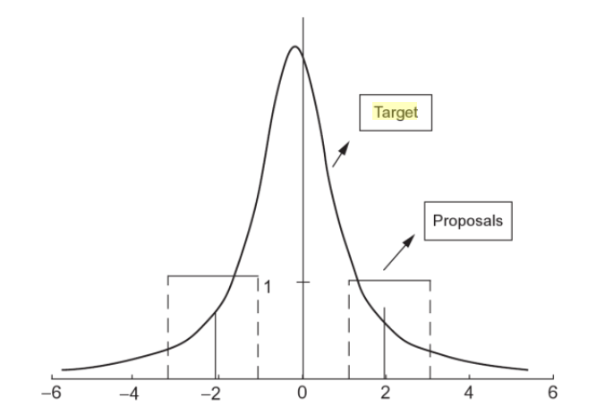
METROPOLIS-HASTINGS ALGORITHM II
Example I [1D]:
target distribution p*: Gaussian
proposal distribution q: uniform distribution, centered at current position
target
proposal
proposal
θ
θ’
θ^{(i)}
θ’
Notes:
If the proposed probability is higher than the current one, always make the move; but there is also a finite probability to make a move to a smaller probability
[better exploration of parameter space and less danger to get stuck in a “local minimum”]

Slide 13
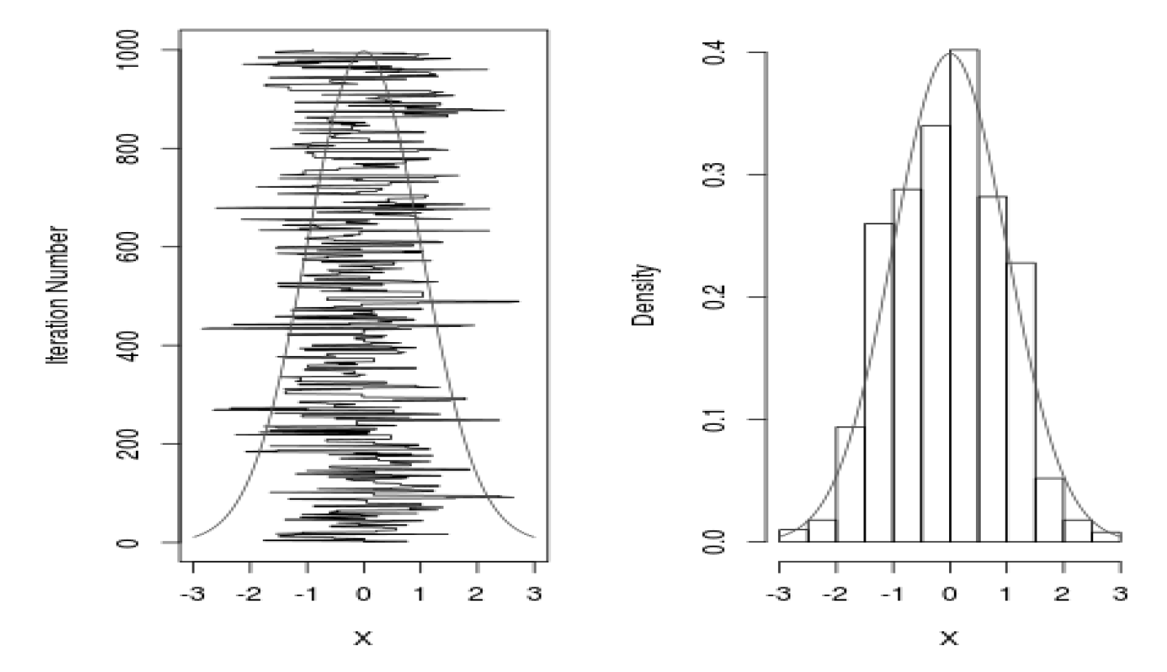
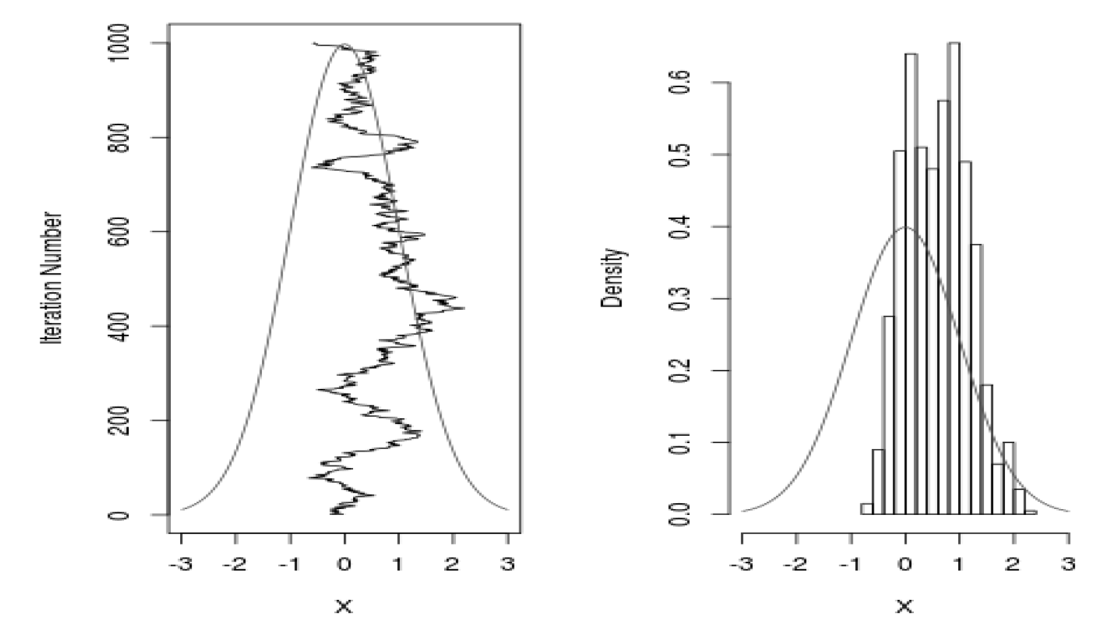
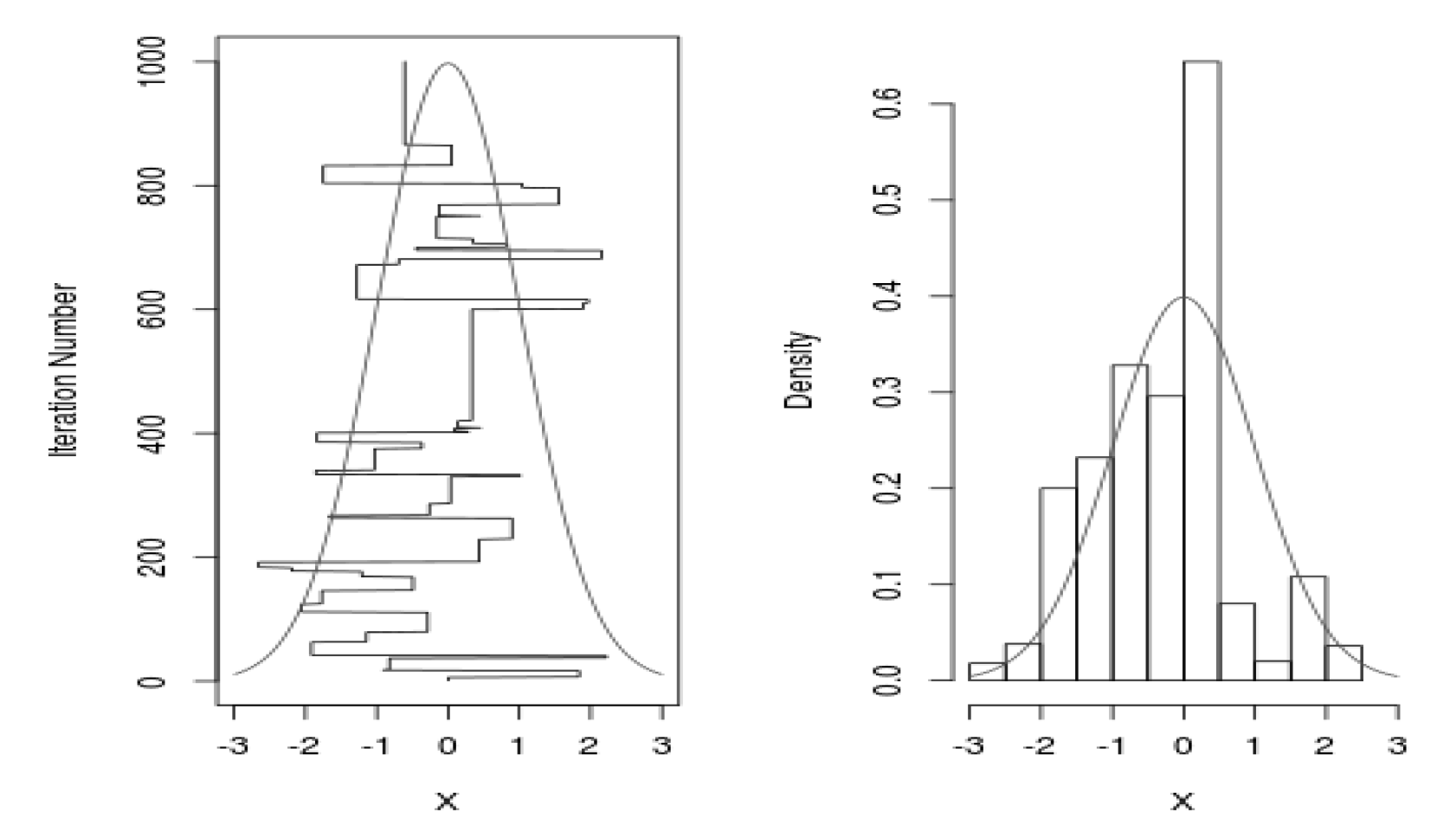
METROPOLIS-HASTINGS ALGORITHM III
σ=2.3, 44% acceptance
Example II [1D]:
target distribution:
Gaussian with p* ~ N(0,1)
proposal distribution:
Gaussian with q ~ N(0,σ²)
σ=0.1, 98% acceptance
σ=25, 5% acceptance
Rosenthal, Statistics in Action. A Canadian Outlook, Ed. J.F. Lawless, Chapman & Hall/CRC (2014)
Notes:
Lower left: chain starts at zero, but jumps are tiny; most jumps are accepted but the chain moves far too slow;
Lower right: many large jumps are being proposed, but the majority of them is not accepted [proposed jumps way out in the tails, all rejected]

Slide 14
EXAMPLE: COUNTING PROBLEM
you observe in a measurement obstot=60 counts; subsequently, you do a background run and observe obsbkg=30 counts for the same running time
but without signal source
what is the best estimate for the true signal counts?
note: observed number of counts ≠ true mean value of counts
[the observed value is especially a poor estimate of the true value when the experimental
uncertainty is of the same order as the intrinsic variance]
starting point of the analysis, designing the model:
true total counts
= true signal counts (s) + true background counts (bkg)
observed total and background counts are distributed as
Poisson distributions:
true mean
observed

Slide 15
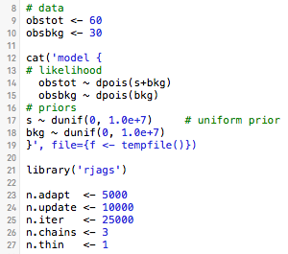
R and JAGS
for description/installation/information, see:
http://www.r-bloggers.com/getting-started-with-jags-rjags-and-bayesian-modelling/
https://cran.r-project.org/web/packages/rjags/rjags.pdf
JAGS stands for “Just Another Gibbs Sampler”, but really includes: Gibbs sampling,
Metropolis-Hastings algorithm, Slice sampling, Adaptive rejection sampling, etc.
data are “distributed as” a
Poissonian, with mean= s+bkg
or mean=bkg
all parameters of the model
[here: s and bkg] need priors
MCMC will return the posteriors of s and bkg [i.e., the credible samples drawn by the chain]
Notes:
JAGS exploits conjugacy when it can recognize it; will use slice sampling, Metropolis, etc. when a conditional distribution is not recognizable in closed form
Unlike R, Fortran, or C [imperative languages], JAGS is a declarative language, i.e., the syntax provided here is a model declaration, and does not define a set of computational steps to be run sequentially. At compilation, the model declaration syntax is turned into a set of instructions that would correspond to a program in the conventional sense, but this is never seen by the user. Therefore, the precise order in which statements are given in the model declaration is unimportant.

Slide 16
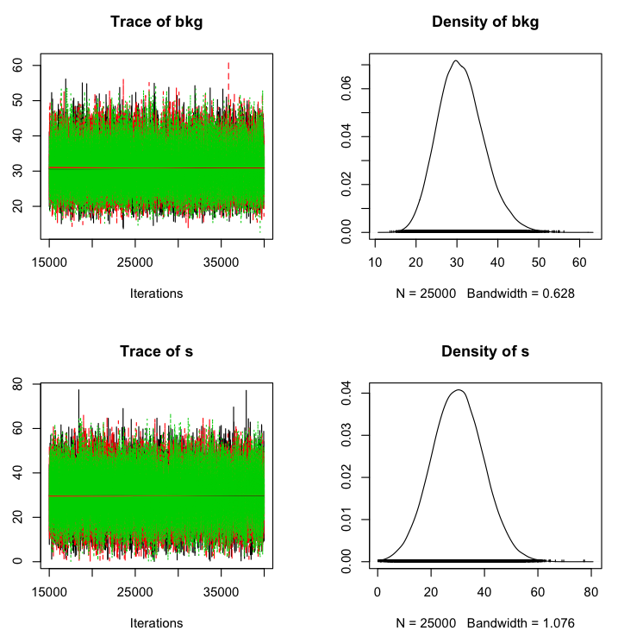
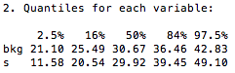
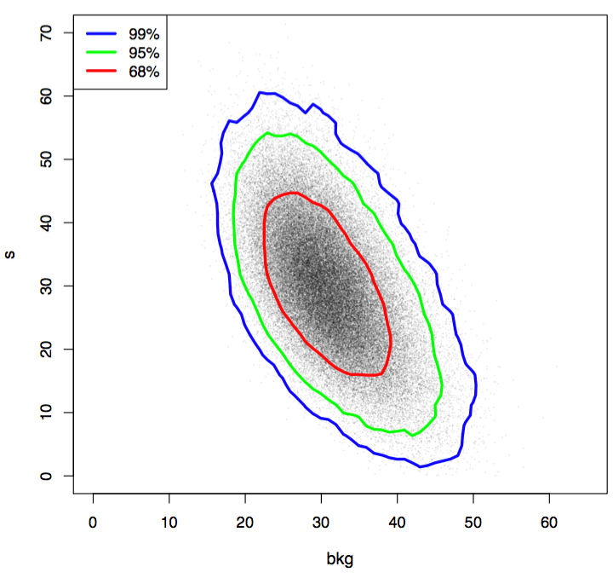
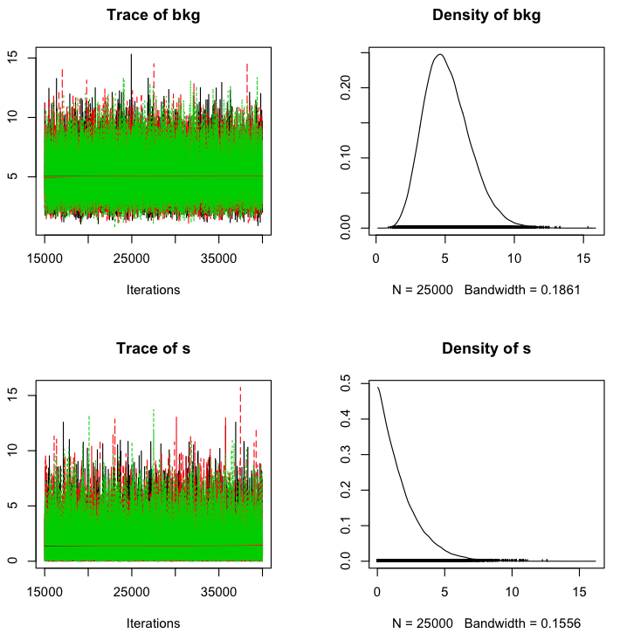
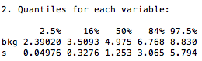
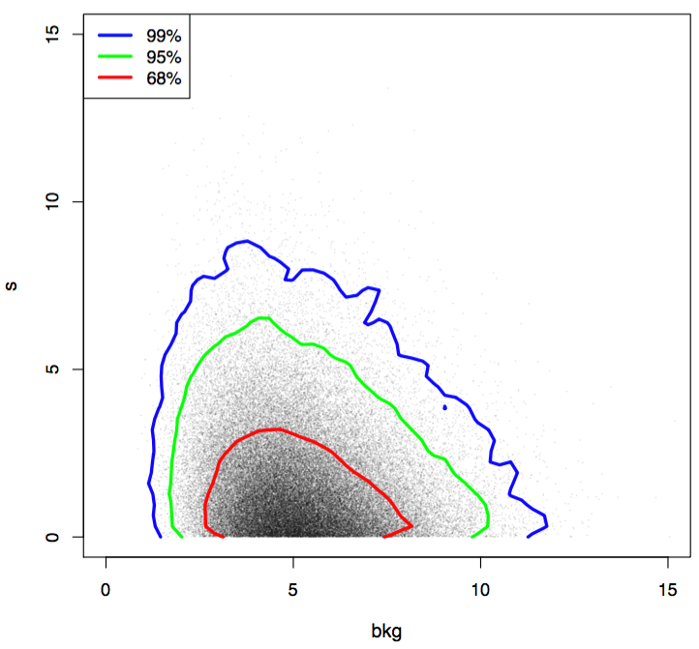
obstot=60
obsbkg=30
obstot=3
obsbkg=7

Slide 17
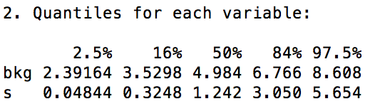
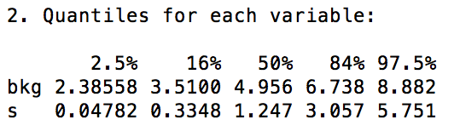
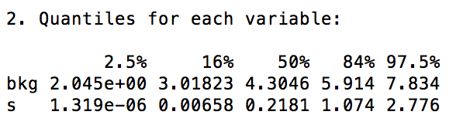
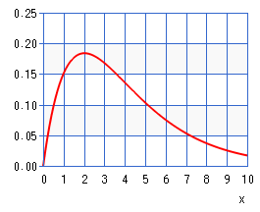
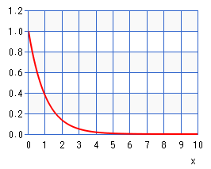
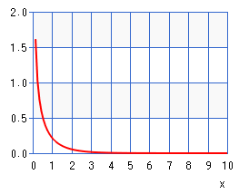
SENSITIVITY TO PRIOR: obstot=3; obsbkg=7
s ~ dgamma(s1, r1)
bkg ~ dgamma(s2, r2)
s1 ~ dunif(0.1, 1.0)
s2 ~ dunif(0.1, 1.0)
r1 ~ dunif(1.0e-6, 1.0e0)
r2 ~ dunif(1.0e-6, 1.0e0)
“hyperpriors”
shape
rate
s ~ dunif(0, 1.0e1)
bkg ~ dunif(0, 1.0e1)
s ~ dgamma(1.0, 0.01)
bkg ~ dgamma(1.0, 0.01)
gamma probability density
[http://keisan.casio.com/exec/system/1180573216]
mean = shape/rate
shape = 1: exponential distribution
shape < 1: diverges at zero
dgamma(2.0, 2.0)
dgamma(1.0, 1.0)
dgamma(0.5, 1.0)
Notes:
middle:
mean value is 100
right:
for the shape, we do not want the downturn towards zero, so we pick a range of 0.1 to 1.0
for the rate, we pick 1e-6 to 1, since shape/rate determines the mean
hyperpriors: “let the data [partially] pick the prior; reduce dependence on assumed functional structure of prior distributions
============
dgamma(s, r) in jags syntax is dgamma(x, shape=s, rate=r) in R syntax;
mean = shape/rate = s/r
mode = (shape-1)/rate = (s-1)/r
sd = sqrt(s)/r
s ~ dgamma(1.0, 0.01)
bkg ~ dgamma(1.0, 0.01)
for shape=1, the gamma distribution = exponential [Kruschke, p. 237]
for shape<1, it diverges at zero

Slide 18
Rjags LAB
install rjags within R [see links provided earlier]
run poissonSIGBG.R. Play around with inputs: priors (s, bkg); n.adapt; n.update; n.iter; …
3. run it for the following conditions:
obstotal=40, 20, 15, 10
obsbkg=5
notice the shape of the posteriors, especially when the probability for obtaining a zero
value for the parameter becomes non-zero
[when you use this code for serious research, you should always explore the sensitivity
of the results to the priors, as discussed on the previous slide]

Slide 19
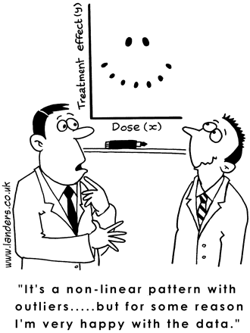
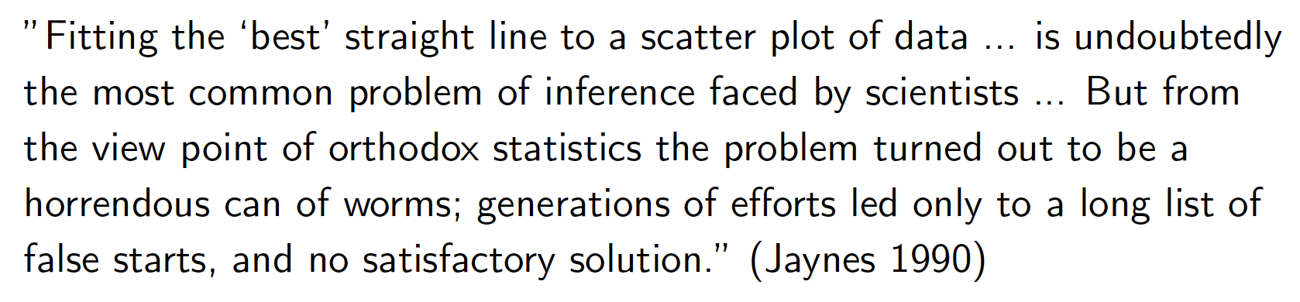
LINEAR REGRESSIONª WITH BAYESIAN STATISTICS
ª Gelman & Hill, Data Analysis using Regression and Multilevel/Hierarchical Models (Cambridge U, 2007)
Notes:
􏱌A “linear model”􏰱 is de􏰬noted as one for which the model equation is linear in the parameters and the noise􏰹 not necessarily in the observations􏰻

Slide 20
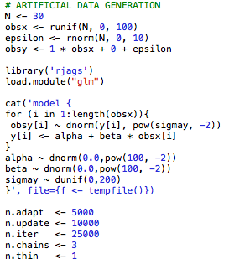
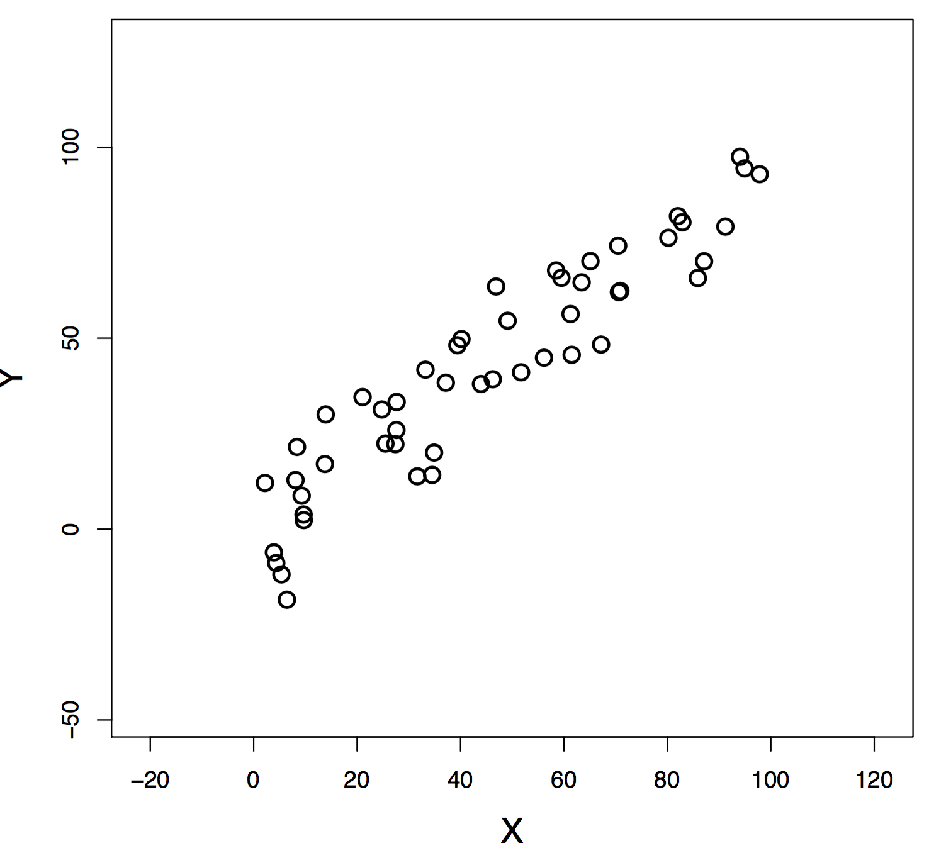
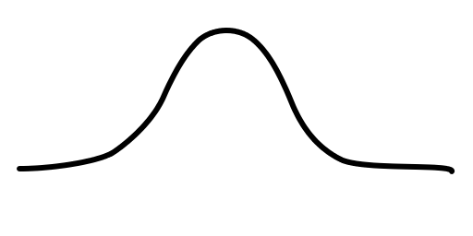
EXAMPLE: REGRESSION WITHOUT ERROR BARS
each data point pulls on the model [regression line] with a weight that is regulated
by how well it is supported by the other data points
Notes:
Data generation: Gaussian noise has mean=0 and sd=10
Setup of model…
Priors…

Slide 21
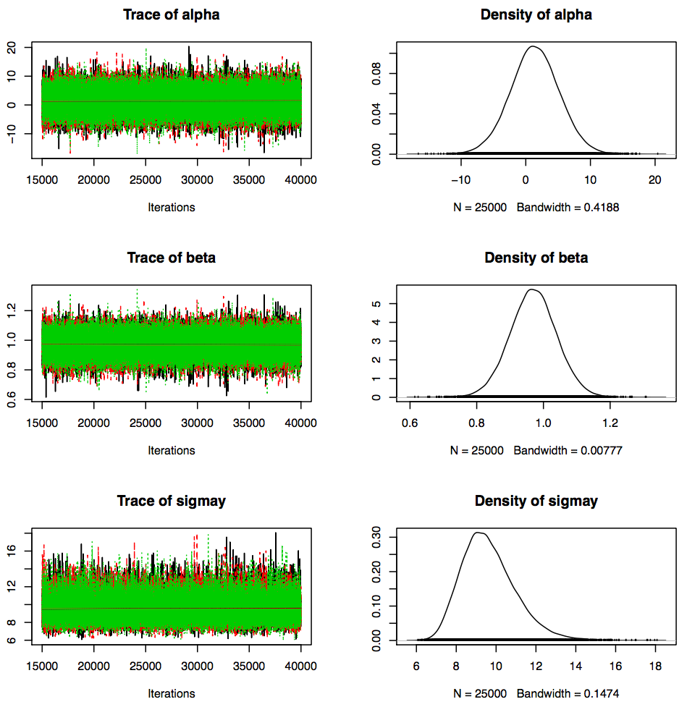
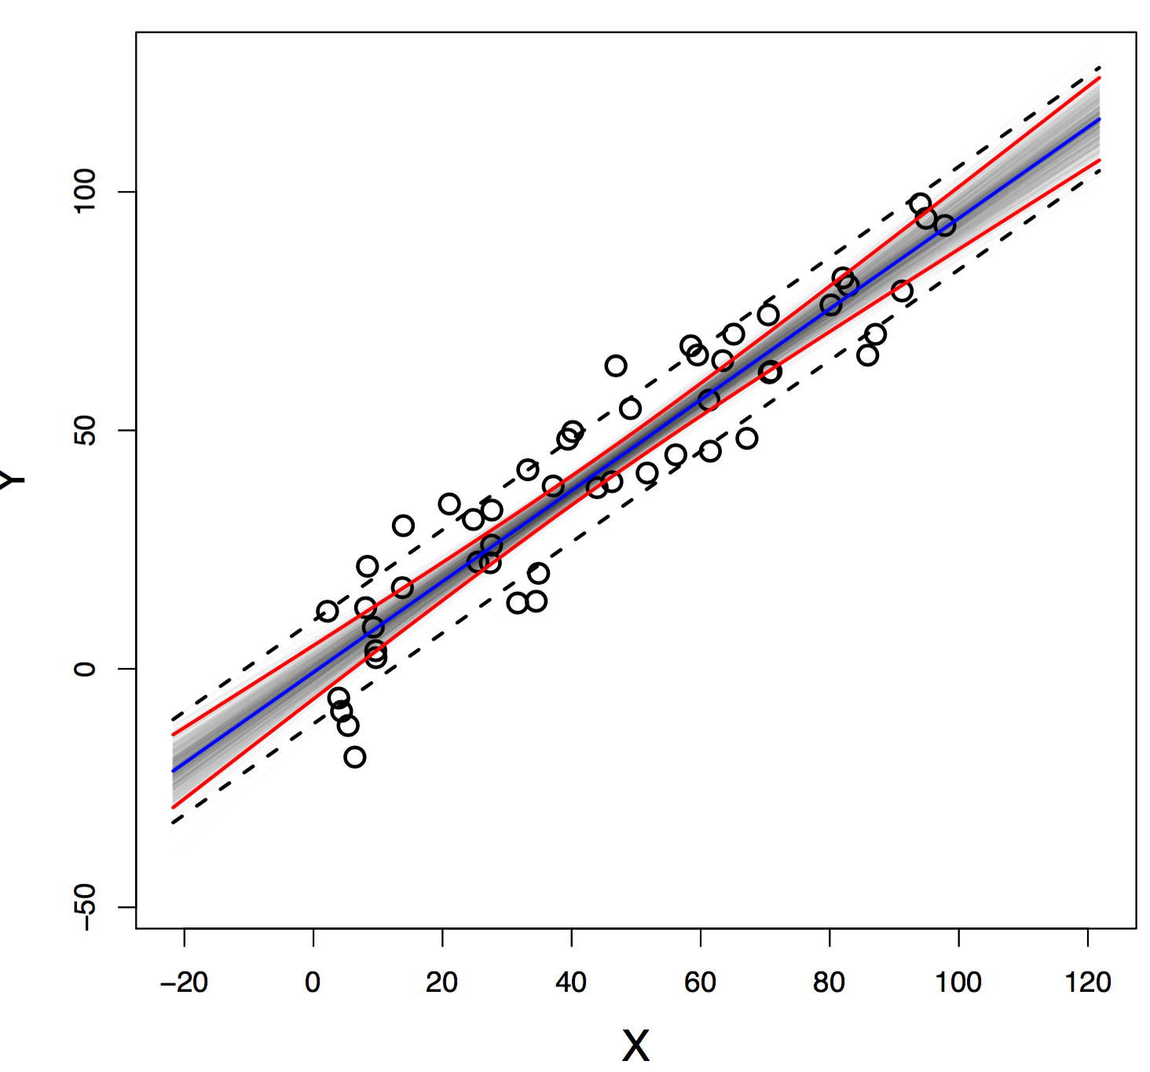
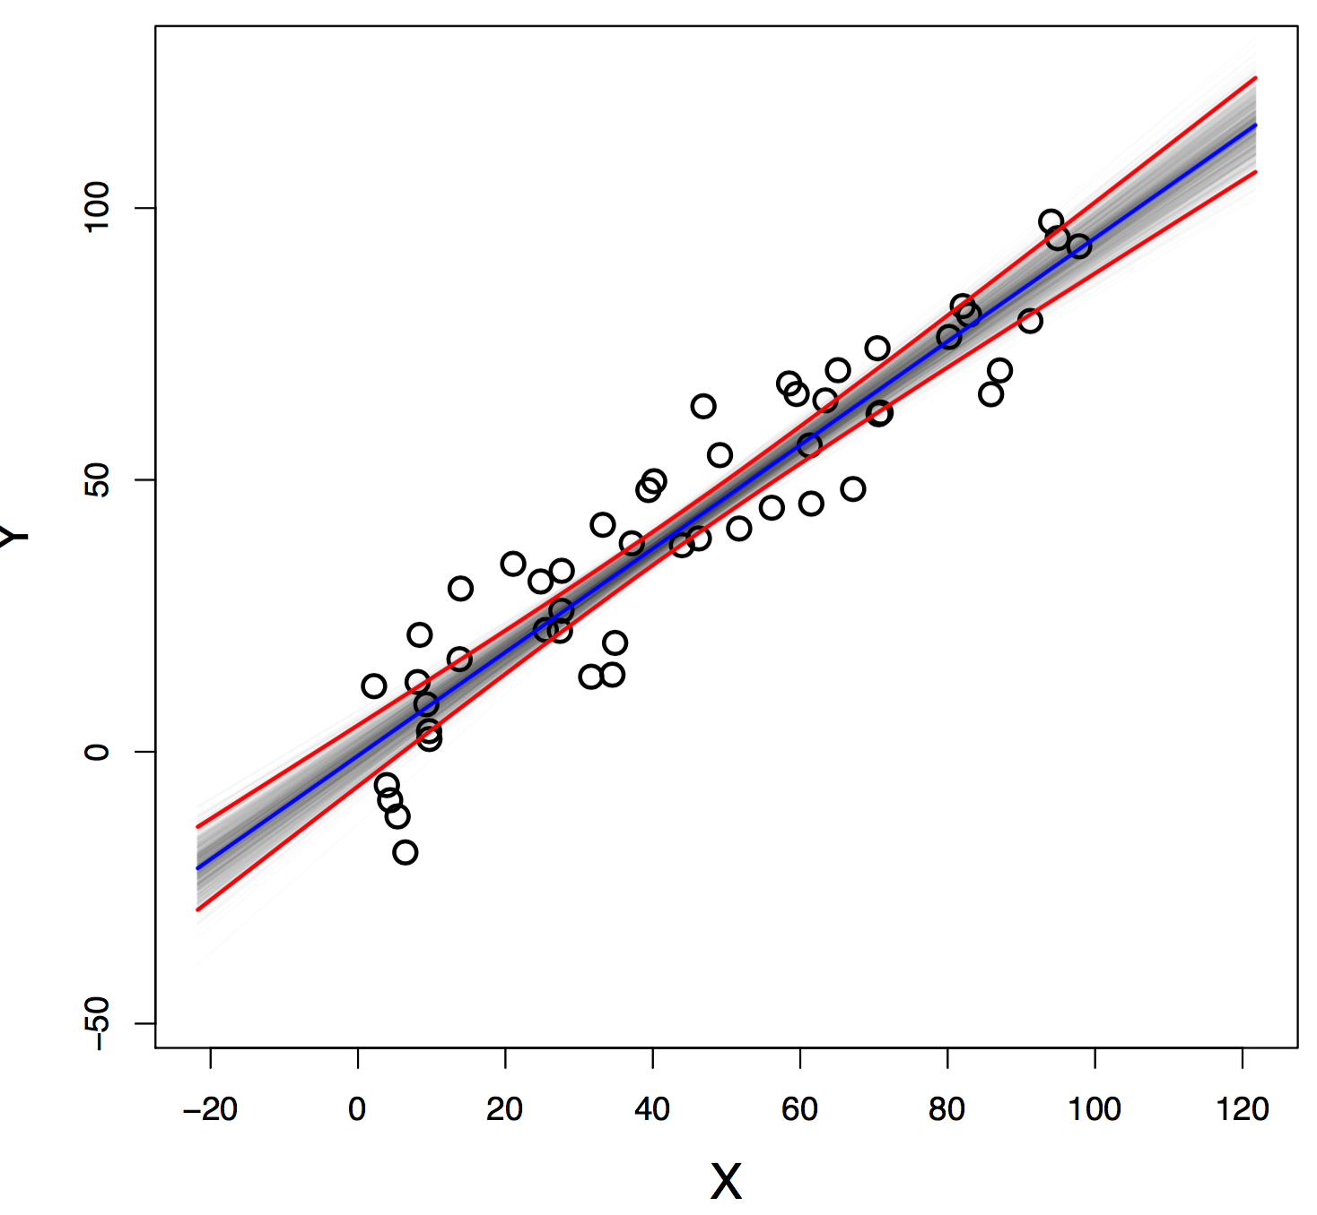
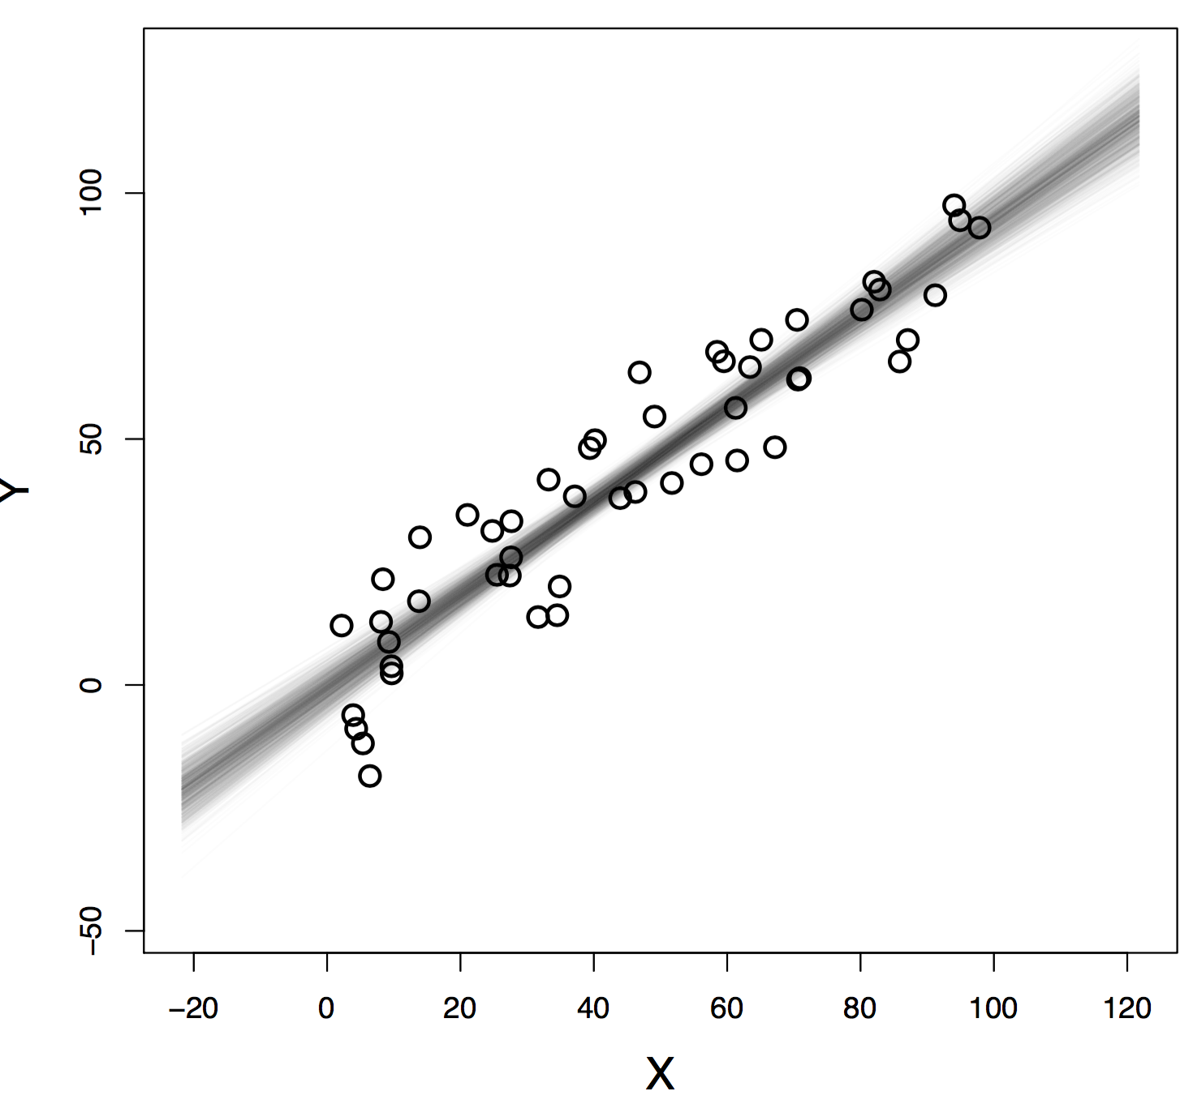
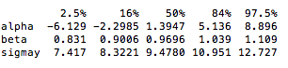
95% credible interval for true regression line,
marginalized over sigmay [important for
predictions]; we are 95% sure that the true
regression line is within the credible interval
marginalized over all other parameters
true parameters
± mean(sigmay); tells us the most
credible region where to expect
new data
Notes:
Notice broadening of credible region towards the ends
we are 95% sure that the true regression line is within the credible interval

Slide 22
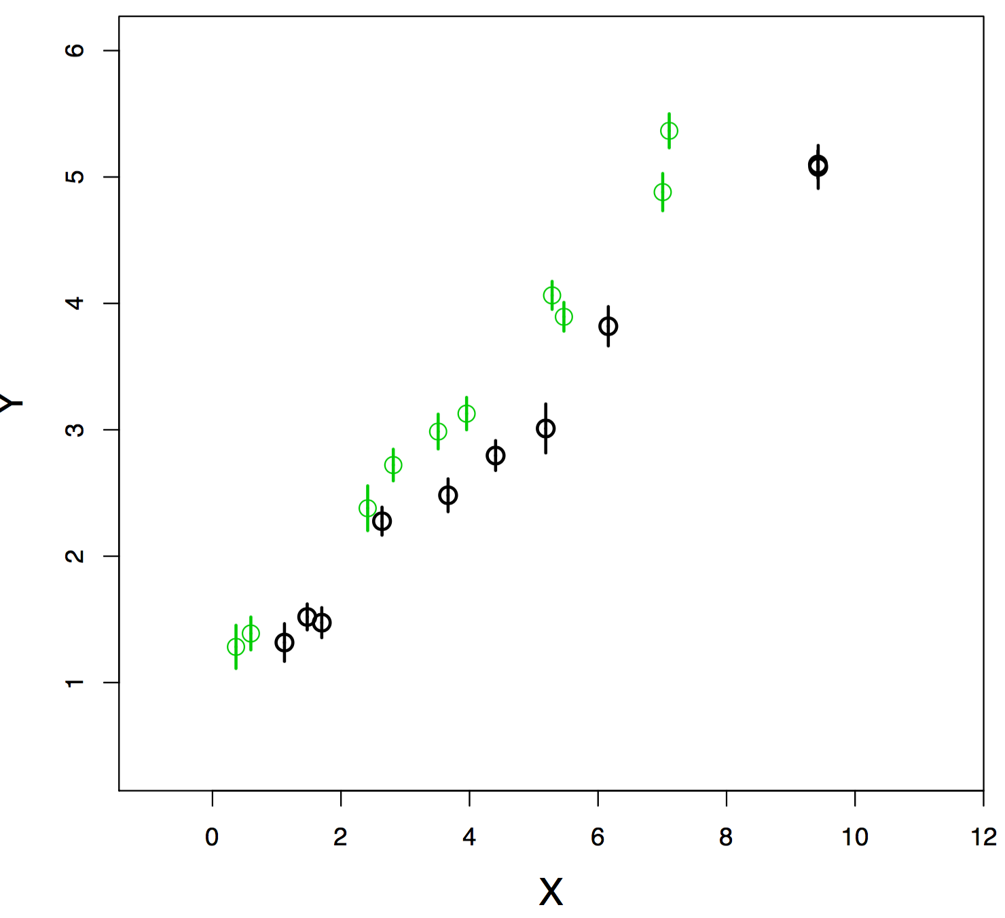
EXAMPLE OF ARTIFICIAL DATA
we suspect: there must be a “systematic effect”
data generation:
assume for “true” relationship: y = 0.5 x + 1
both sets have small individual errors
[between 0.1 and 0.2]
the first one is shifted down by factor 0.9, the
second one up by factor 1.1
Notes:
There must be a ”systematic effect”

Slide 23

WHAT DO POLITICIANS KNOW ABOUT STATISTICS?
Press Conference at NATO-HQ on June 6-7, 2002, by the
former US Secretary of Defense
Donald Rumsfeld
Question:
“Regarding terrorism and weapons of mass destruction, you said something to the effect that the real situation is worse than the facts show. I wonder if you could tell us what is worse than is generally understood.”
Answer:
“…As we know, there are known knowns; there are things we know we know. We also know there are known unknowns; that is to say we know there are some things we do not know. But there are also unknown unknowns—there are things we don’t know we don’t know…It sounds like a riddle. It isn’t a riddle…”
statistical uncertainties → “known knowns” → we know their pdf
known systematic uncertainties → “known unknowns” → we do not know their pdf
unknown systematic uncertainties → “unknown unknowns” → hope for the best
Notes:
…2002, as the George W. Bush administration was launching its campaign to invade Iraq…
statistical errors: known knowns → we know the pdf to use
[known] systematic errors: known unknowns → we have some idea on their magnitude [but we do not know their pdf; otherwise we could correct for the effect]
[unknown] systematic errors: unknown unknowns → we can only hope that these are small in magnitude, whatever they are
What about unknown knowns?

Slide 24
SYSTEMATIC ERRORS: GENERAL ASPECTS
statistical errors: when performing many independent measurements, results will
vary; their effect can be reduced by combining results
systematic errors: if measurement is repeated: do not decrease; may not cause
different answers
systematic effect: shifts all data points in the same direction [differs from an intrinsic
scatter]; frequently treated as offset or normalization
how errors are frequently reported in nuclear physics:
‹S(E)›_{j} ± 5 (stat) keV ± 3 (sys) keVb [offset]
‹S(E)›_{j} keVb ± 5% (stat) ± 3% (sys) [normalization factor]
the true value of offset/normalization factor is unknown [otherwise there would be no systematic error]
we do know the expected value: 0 for offset/1 for normalization factor
[otherwise we would have corrected the data for the systematic effect]
Heinrich & Lyons, “Systematic Errors”, Annu. Rev. Nucl. Part. Sci 57, 145 (2007)

Slide 25
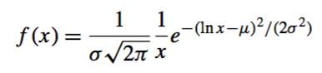
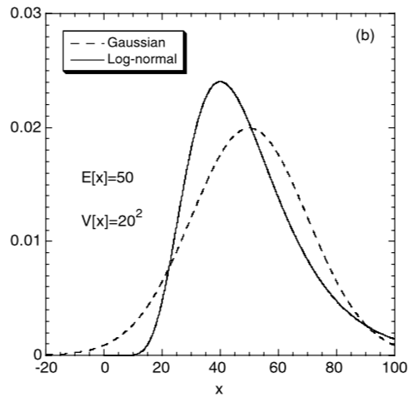
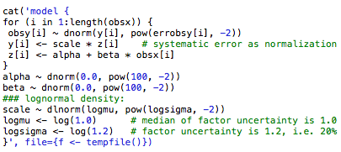
SYSTEMATIC ERRORS IN A BAYESIAN MODEL
suppose you determined a systematic uncertainty of 20%...
lognormal distribution
systematic error as normalization [or scale] factor
all data points shift into same direction by same relative amount
systematic effect included as lognormal prior with median
of 1.0 and factor uncertainty of 1.2 [i.e., 20%]
[“highly informative prior”]
median=e^{μ}
factor uncertainty=e^{σ}
Notes:
We assume that statistical and systematic errors are uncorrelated; frequently the case if you think of counting measurements in nuclear physics
We know that median=1.0 [otherwise we would have corrected the data]; !!! remember: median of lognormal density = geometric mean !!!
Factor uncertainty corresponds to the usually reported “systematic error”, i.e., +-20% corresponds to f.u.=1.2
Tried to use a uniform prior, dunif[0.8,1.2] for a 20% systematic error, which also seems to work

Slide 26
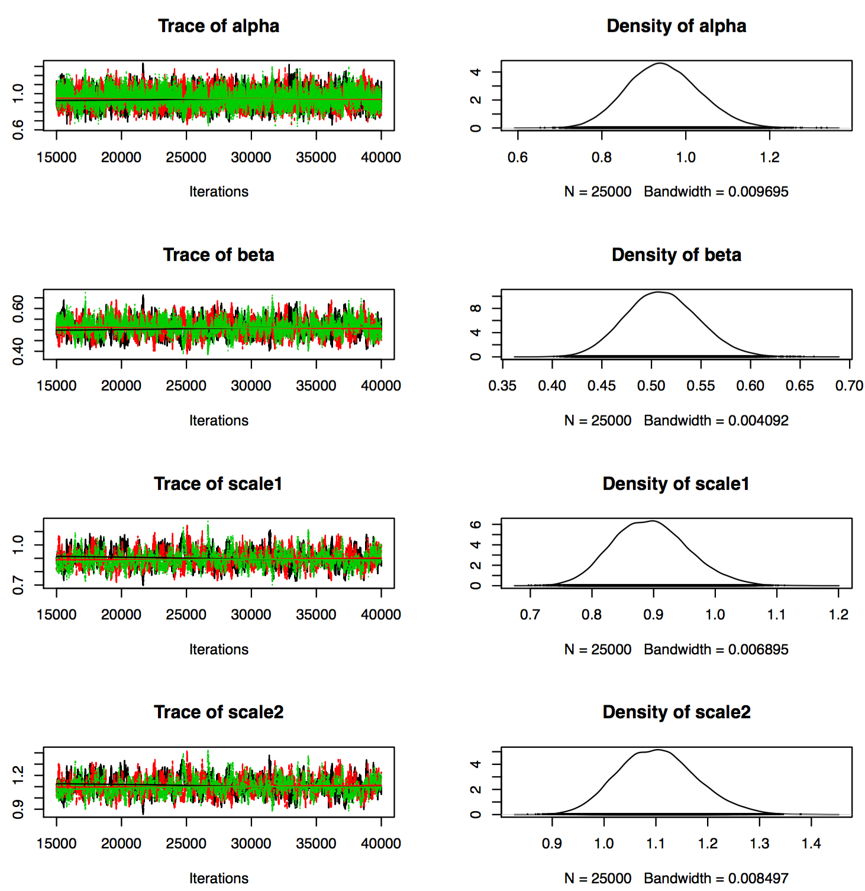
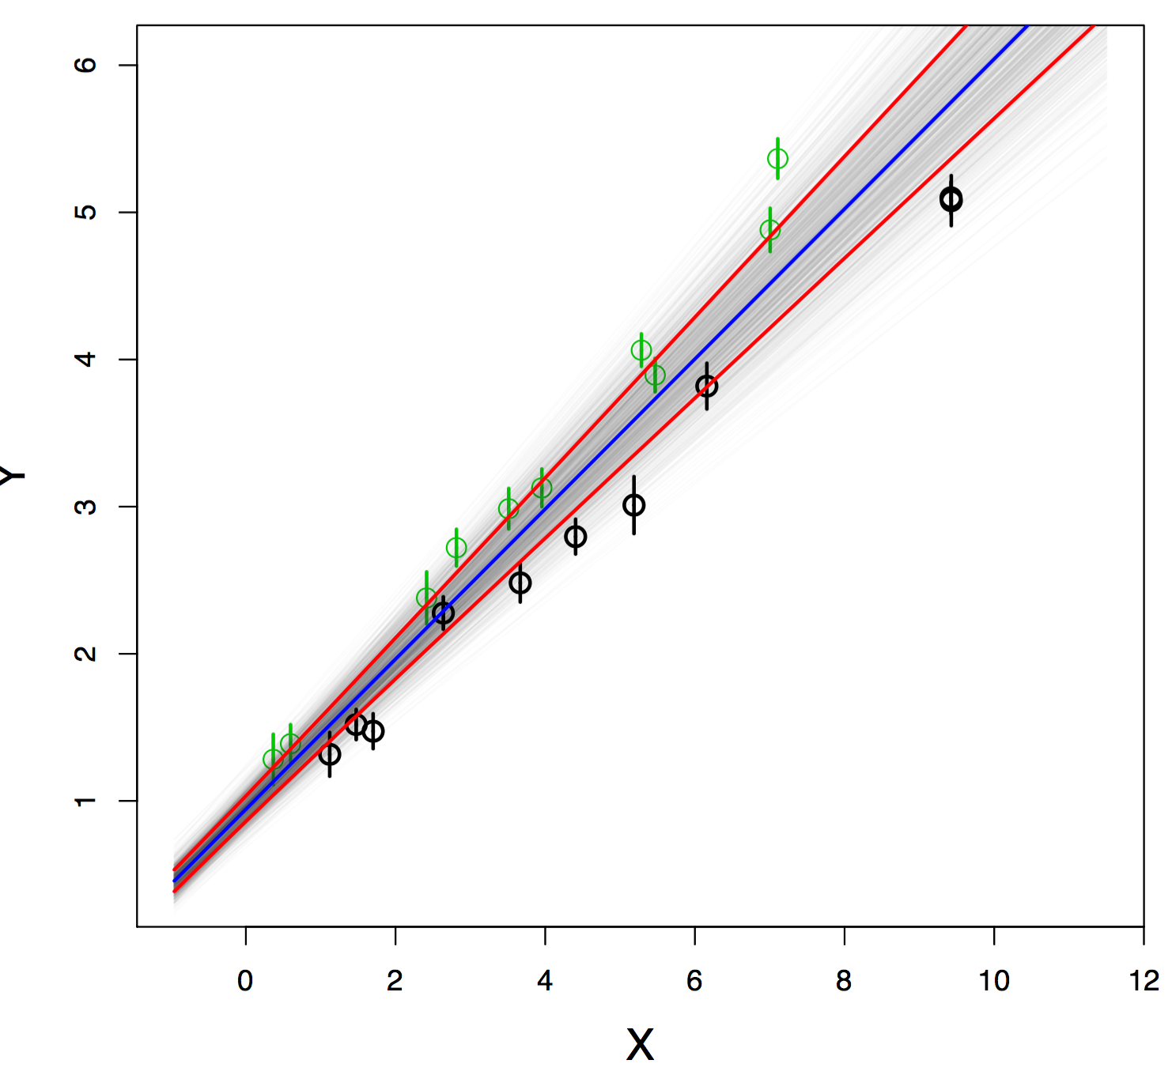
RESULTS FOR THE PREVIOUS EXAMPLE

Slide 27
STATISTICAL ERRORS IN A BAYESIAN MODEL
likelihood function dominated by counting
statistics [Poissonian]
you suspect that there is a finite chance of
zero probability at S=0 [i.e., lognormal can’t
be correct]
mean
standard
deviation
S=xx ± yy
S=(a1 a2 a3 …)/(b1 b2 b3 …)
likelihood function should be lognormal
S-factor (linear scale)
lognormal parameters are obtained from xx and yy
notice that lognormal function predicts zero probability for S=0
Energy
tests with JAGS, simple counting experiment:
obstotal = 40, 20, 15, 10
obsbkg = 5
signal = total – background
uniform priors between 0 and 1000
[other priors give similar results]
when (xx/yy) < 3, a lognormal likelihood cannot
be used [→ disregard those data points]

Slide 28
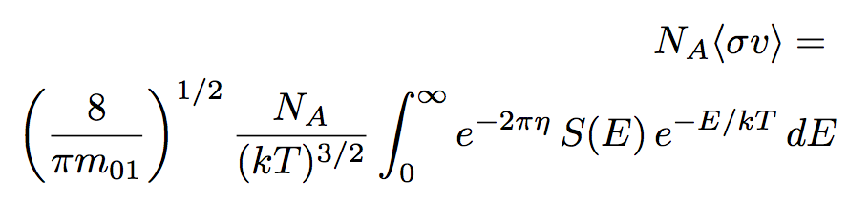
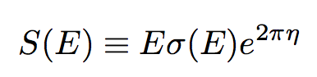
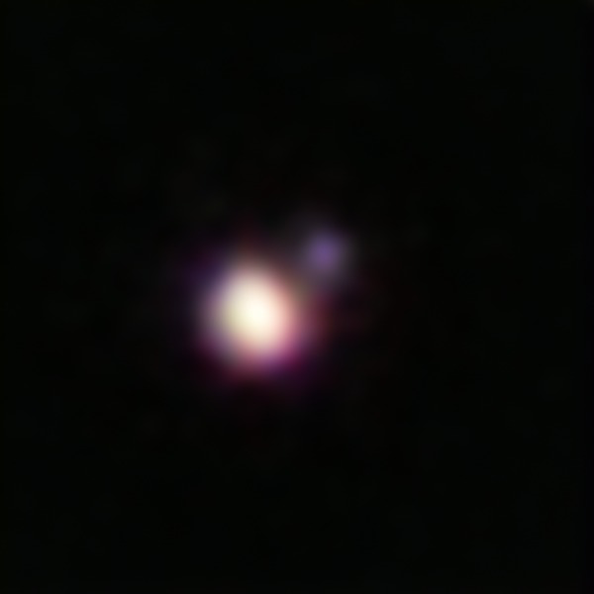
ASTROPHYSICAL S-FACTORS AND REACTION RATES
reaction rate: number of reactions per volume per time
example: d(p,γ)³He
important for:
big bang nucleosynthesis*
[determines abundances of d, ³He, ⁷Li]
deuterium burning in stars
brown dwarfs [<0.08 M_{sol}]: 15-85 Jupiter masses
*Coc et al., PRD, 92, 123526 (2015)
Brown dwarf binary CFBDSIR 1458+ 10
Notes:
This image of the brown dwarf binary CFBDSIR 1458+10 was obtained using the Laser Guide Star (LGS) Adaptive Optics system on the Keck II Telescope in Hawaii. Adaptive optics cancels out much of Earth’s atmospheric interference, improving the image sharpness by a factor of ten and enabling the very small separation binary to be resolved. This is the coolest pair of brown dwarfs found so far—the colder and dimmer of the two components is a candidate for the brown dwarf with the lowest temperature ever found. This colour picture was created from images taken through four different filters at near-infrared wavelengths.

Slide 29
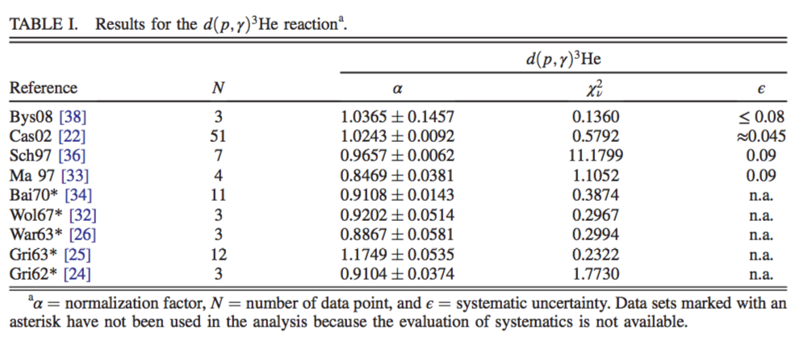
DATA FOR d(p,γ)³He
statistical
uncertainties
systematic
uncertainties
S-factor (MeVb)
disregard
MA97: Ma, Karwowski, et al., PRC 55, 588 (1997) [TUNL] CAS02: Casella et al., NPA, 706, 203 (2002)
SCH97: Schmid et al., PRC 56, 2565 (1997) [TUNL] BYS08: Bystritsky et al., NIMA, 595, 543 (2008)

Slide 30
S-FACTOR FOR d(p,γ)³He
fit is assuming theoretical reaction model of Marcucci, Viviani, Schiavilla, Kievsky et al.,
PRC, 55, 588 (1997) [available as a table of E vs. S(E)];
there is only one parameter, i.e., the overall scale factor

Slide 31
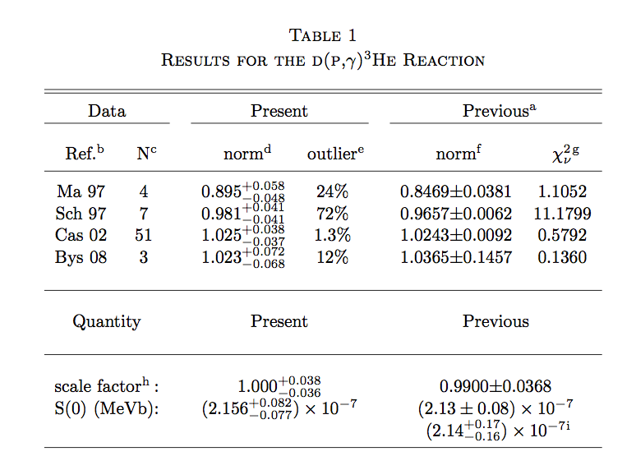
DETAILED COMPARISON OF RESULTS
traditional
analysis
Coc et al., PRD, 92, 123526 (2015)
Bayesian
analysis
Adelberger et al., RMP 83, 195 (2011)

Slide 32
BAYESIAN REACTION RATES
reaction rates are found by numerical integration of the Bayesian S-factor
rate probability density contains all credible S-factors
from the probability densities, recommended rates and the parameters of the lognormal
approximation are computed
STARLIB
http://starlib.physics.unc.edu/index.html

Slide 33
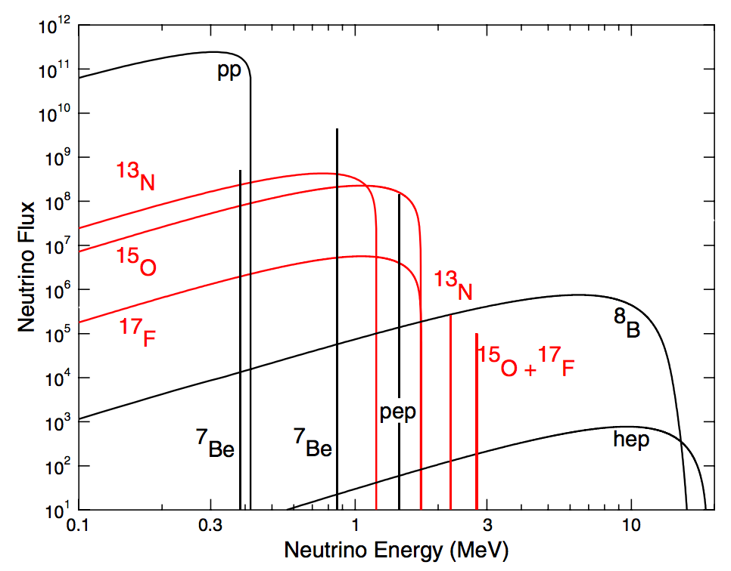
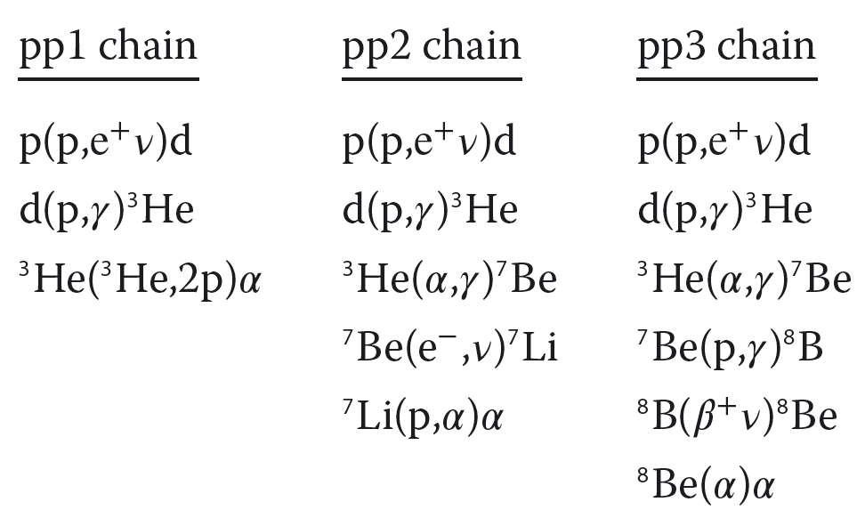
ANOTHER EXAMPLE: ³He(³He,2p)⁴He
Adelberger et al., RMP 83, 195 (2011)
determines relative neutrino fluxes from pp/pep [pp1 chain] versus ⁷Be/⁸B decay [pp2 and pp3 chains]
ratio is important for future strategies to better constrain neutrino oscillation parameters and matter effects, through comparison of high-energy (matter influenced) and low-energy (vacuum) fluxes
enters in computing the neutrino energy losses of the Sun, and thus influences the connection between the Sun’s photon luminosity and its total energy production

Slide 34
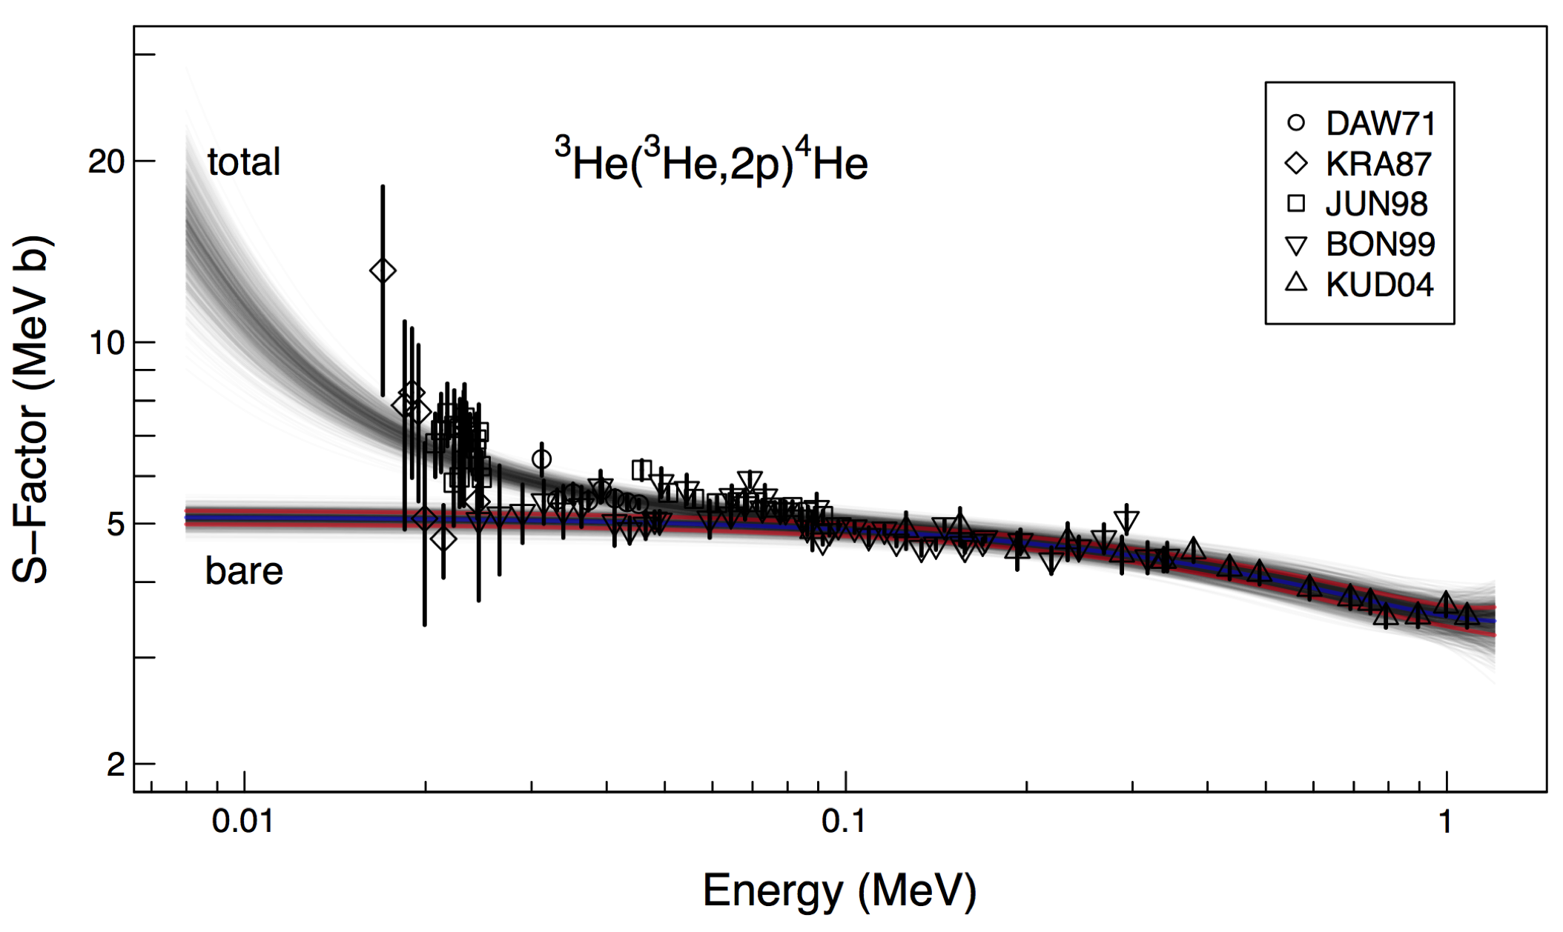
S-FACTOR FOR ³He(³He,2p)⁴He
fit is assuming a quadratic polynomial for the “bare” S-factor, multiplied by an exponential
that includes the electron screening potential
there are 4 parameters: S(0), S’(0), S’’(0), U_{e}

Slide 35
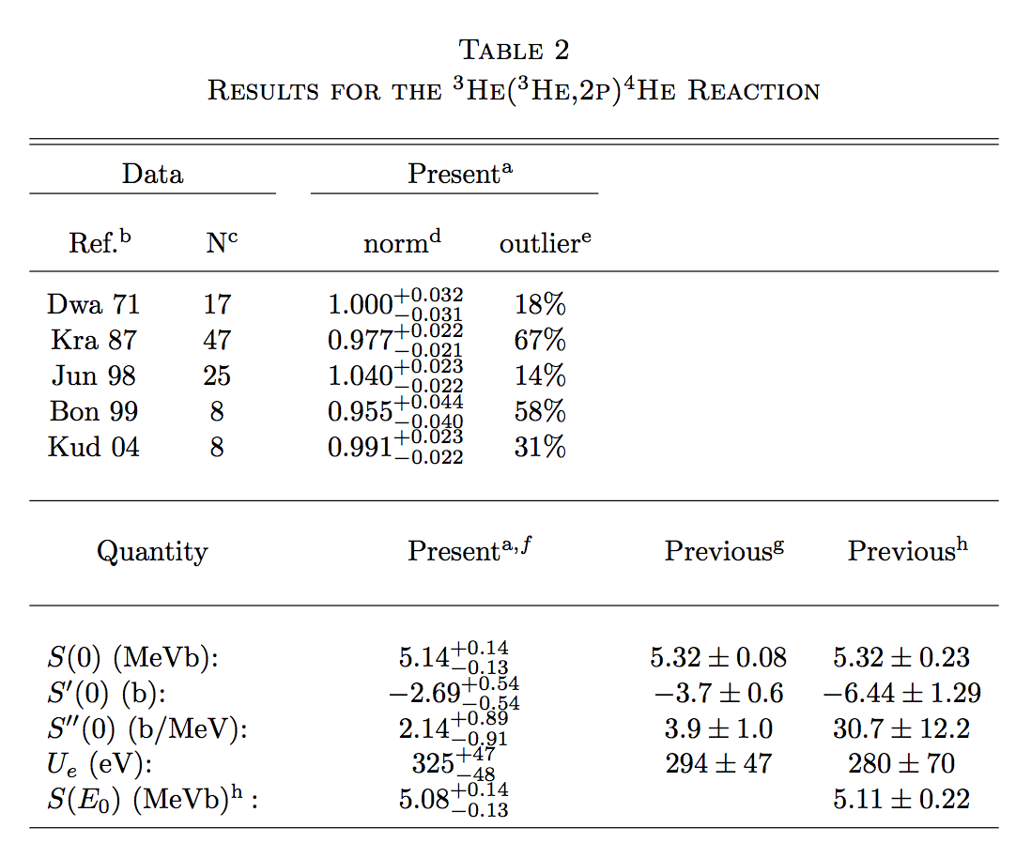
DETAILED COMPARISON OF RESULTS
traditional
analysis
Bayesian
analysis
Adelberger et al., RMP 83, 195 (2011)
Bonetti et al., PRL 82, 5205 (1999)

Slide 36
EXTRA SLIDES

Slide 37
BAYYES THEOREM: DERIVATION
Notes:
Interesting thing: Bayesian theorem applied to data (B)

